Slide 1


Android Internals

Slide 2

Table of Contents
Introduction to Android System Programming: 4
Setting Up the Development Environment: 28
Discovering Kernel, HAL, and Virtual Hardware: 65
Customizing the Android Emulator
Enabling the ARM Translator and Introducing Native Bridge
Debugging the Boot Up Process Using a Customized ramdisk
Enabling Wi-Fi on the Android Emulator
Creating Your Own Device on VirtualBox
Booting Up x86vbox Using PXE/NFS

Slide 3
Table of Contents
10. Enabling Graphics
11. Enabling VirtualBox-Specific Hardware Interfaces
12. Introducing Recovery
13. Creating OTA Packages
14. Customizing and Debugging Recovery

Slide 4
Introduction to Android System Programming

Slide 5
Introduction to Android System Programming
In summary, we will cover the following topics in this lesson:
Introduction to Android system programming
Overview of the Android system architecture
Introduction to the third-party projects used in this course
Introduction to virtual hardware platforms
Notes:
Introduction to Android System Programming
This course is about Android system programming. In this lesson, we will start with a discussion on system programming and the scope of Android system programming (to give a high-level view of this course). After that, we will look at the Android system architecture. From the architecture, we can see the layers that we will focus on in this course. We will also talk about the virtual hardware platforms and third-party open source projects that we will use in this course.

Slide 6
What is system programming?
When we talk about what system programming is, we can start with the definition of system programming in Wikipedia:
"System programming (or systems programming) is the activity of programming system software. The primary distinguishing characteristic of systems programming when compared to application programming is that application programming aims to produce software which provides services to the user (e.g. word processor)
Notes:
whereas systems programming aims to produce software and software platforms which provide services to other software, are performance constrained, or both (e.g. operating systems, computational science applications, game engines and AAA video games, industrial automation, and software as a service applications). "
From the preceding definition, we can see that when we talk about system programming we actually deal with the building blocks of the computer system itself. We may depict the system architecture and how it looks like inside the system. As an example, we can refer to system programming books for Windows or Linux. The course Linux System Programming published by O'Reilly Media, Inc. includes topics about file I/O, process management, memory management, interrupt handling, and so on. There is another course called Windows System Programming published by Addison-Wesley Professional that includes very similar topics to its Linux counterpart.
You may expect similar content in this course for Android, but you will find that the topics in this course are quite different from the classic system programming course. First of all, it doesn't really make sense to have a system programming course for Android talk about file I/O, process management, or memory management, because the Linux System Programming course can cover almost the same topics for Android (Android uses Linux kernels and device driver models).
When you want to explore kernel space system programming, you can read books such as Linux Device Drivers by O'Reilly or Essential Linux Device Drivers from Prentice Hall. When you want to explore user space system programming, you can read the course that I mentioned before, Linux System Programming by O'Reilly. Then you may wonder, Do we need an Android System Programming course in this case? To answer this question, it depends on how we look at system programming for Android. Or in other words, it depends on which angle we look at Android System Programming from. We can tell people different things about the same world from different perspectives. In that sense, we may need more than one course to talk about Android system programming.
To talk about Android system programming, we can talk about it theoretically or practically. In this course, we will do it practically with a few actual projects and hands-on examples. Our focus will be how to customize the Android system and how to port it to a new platform.

Slide 7
What is the scope of this course?
As we know, there are two kinds of programming for Android: application programming and system programming.
Usually, it is hard to draw a line between system programming and application programming, especially for C language-based operating systems, such as Linux and all kinds of Unix system.
With the Android framework, the application layer is separated nicely from the rest of the system.
Notes:
You may know that Android application programming uses the Java language and Android system programming using Java, C/C++, or assembly languages. To make it simple, we can treat everything other than application programming in the Android world as the scope of system programming. In this sense, the Android framework is also in the scope of system programming.
From the perspective of the audiences of this course, they may want to learn more about the layers they may touch on in their project work. The Android framework is a layer that will be changed by Google only in most cases. From this point of view, we won't spend too much time talking about the framework itself. Instead, we will focus on how to port the system including the Android framework from the standard platforms in Android Open Source Project (AOSP) to other platforms. We will focus on the layers that need to be changed during the porting process in this course.
After we have done the porting work, a new Android system will be available. One thing that we need to do for the new system is deliver the changes for the new system to the end users from time to time. It could be a major system update or bug fixing. This is supported by over-the-air (OTA) updates in Android. This is also one of the topics in this course.
Traditionally, all Unix programming was system-level programming. Unix or Linux programming is built around three cornerstones, which are system calls, the C library, and the C compiler. This is true for Android system programming as well. On top of the system calls and C library, Android has an additional layer of abstraction for the Android application level. This is the Android framework and Java virtual machine.
In that sense, most Android applications are built using Android SDK and Java language. You may be wondering whether it is possible to do Android application development using C/C++ or even do system level programming using Java. Yes, all these are possible. Besides Android SDK, we can also develop native applications using Android NDK. There are also a lot of Android framework components developed using the Java language. We can even develop Android applications using C# with Visual Studio (Xamarin). However, we won't go to that kind of complexity in this course. We will focus on the layers below the application framework. Again, the focus will be on customizing and extending the existing system or porting the entire system to a new hardware platform.
The reason why we will focus on the porting of Android systems and the customization of Android systems is because these are what most people working on the Android system level will do. After Google releases a new version of Android, silicon vendors need to port the new version to their reference platform. When OEM/ODM companies get the reference platform, they have to customize the reference platform to their products. The customization includes the build of the initial system itself and the deployment of the updates to the deployed system. In the first part of this course, we will discuss the porting of Android systems. In the second part of this course, we will discuss how to update the existing system.

Slide 8
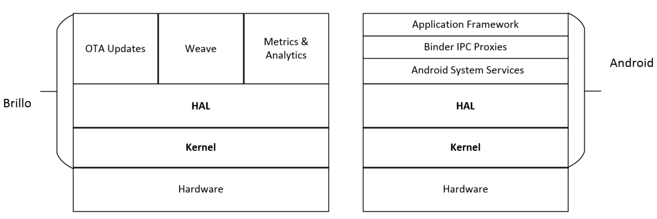
What is the scope of this course?
Notes:
If we consider the architecture of Android in the right-hand side of the following figure, we can see that most porting work will focus on the Kernel and Hardware Abstraction Layer (HAL) in the Android system architecture. This is true for other Android derivatives as well. The knowledge and concepts in this course can apply to Android wearables and Brillo as well. The left-hand side of the following figure, it shows the architecture diagram of Brillo. Brillo is the IoT operating system from Google for IoT devices. It is a simpler and smaller version of Android for IoT devices. However, the porting layer is still the same as Android.
Overview of the Android system
As we can see from the architecture diagram, the architecture layers of Android include Application Framework, Android System Services, HAL, and Kernel. Binder IPC is used as a mechanism for inter-process communication. We will cover each of them in this section. Since recovery is also part of the system programming scope, we will also give an overview of recovery in this section.
You can find more information about key porting layers and system architecture internals at the following Google website: http://source.android.com/devices/index.html

Slide 9
Kernel
As we know, Android uses the Linux kernel. Linux was developed by Linus Torvalds in 1991. The current Linux kernel is maintained by the Linux Kernel Organization Inc.
The latest mainline kernel releases can be found at https://www.kernel.org.
Android uses a slightly customized Linux kernel.
Notes:
The following is a concise list of the changes to the Linux kernel:
ashmem (Android Shared Memory): A file-based shared memory system to user space
Binder: An interprocess communication (IPC) and remote procedure call (RPC) system
logger: A high-speed in-kernel logging mechanism optimized for writes
paranoid networking: A mechanism to restrict network I/O to certain processes
pmem (physical memory): A driver for mapping large chunks of physical memory into user space
Viking Killer: A replacement OOM killer that implements Android's "kill least recently used process" logic under low-memory conditions
wakelocks: Android's unique power management solution, in which the default state of the device is sleep and explicit action is required (via a wakelock) to prevent that
Most of the changes were implemented as device drivers with little or no changes necessary to the core kernel code. The only significant subsystem-spanning change is wakelocks.
There are many Android patches accepted by the mainline Linux kernel today. The mainline kernel can even boot up Android directly. There is a blog from Linaro about how to boot Nexus 7 running a mainline kernel. If you want to try it, you can find the instructions at https://wiki.linaro.org/LMG/Kernel/FormFactorEnablement.
If a Linux device driver is available for a hardware device, it usually can work on Android as well. The development of device drivers is the same as the development of a typical Linux device driver. If you want to find out the merges on the mainline kernel related to Android, you can check the kernel release notes at https://kernelnewbies.org/LinuxVersions.
The Android kernel source code is usually provided by SoC vendors, such as Qualcomm or MTK. The kernel source code for Google devices can be found at https://android.googlesource.com/kernel/.
Google devices use SoC from various vendors so that you can find kernel source code from different vendors here. For example, the kernel source of QualComm SoC is under kernel/msm and the kernel source of Mediatek is under kernel/mediatek. The general Android kernel source code is in the folder kernel/common, which looks much like the Vanilla kernel.
The default build of AOSP is for various devices from Google, such as Nexus or Pixel. It started to include some reference boards from silicon vendors as well recently, such as hikey-linaro, and so on. If you need a vendor-specific Android kernel for your reference platform, you should get the kernel source code from your platform vendors.
There are also open source communities maintaining Android kernels. For example, the kernel for the ARM architecture can be found at Linaro for many reference boards. For Intel x86 architecture, you can find various versions of kernels in the Android-x86 project. As you can see from the following Linaro Linux Kernel status website, the linaro-android tree is a forward port of the out-of-tree AOSP patches. It provides a preview of what Google's next AOSP kernel/common.git tree "might" look like.
The Linaro Android kernel tree can be found at https://android.git.linaro.org/gitweb/kernel/linaro-android.git. The status of this kernel tree can be seen at https://wiki.linaro.org/LMG/Kernel/Upstreaming.

Slide 10
HAL
HAL defines a standard interface for hardware vendors to implement and allows Android to be agnostic about lower-level driver implementations.
HAL allows you to implement functionality without affecting or modifying the higher level system.
HAL implementations are packaged into module (.so) files and loaded by the Android system at the appropriate time.
Notes:
This is one of the focuses for porting Android systems to a new platform. We will discover more about HAL in lesson 3, Discovering Kernel, HAL, and Virtual Hardware. Throughout this course, I will give a very detailed analysis of the HAL layer for various hardware interfaces.

Slide 11
Android system services
Functionality exposed by application framework APIs communicates with system services to access the underlying hardware.
There are two groups of services that application developers may interact mostly with.
They are system (services such as window manager and notification manager) and media (services involved in playing and recording media).
Notes:
These are the services that provide application interfaces as part of the Android framework.
Besides these services, there are also native services supporting these system services, such as SurfaceFlinger, netd, logcatd, rild, and so on. Many of them are very similar to Linux daemons that you may find in a Linux distribution. In a complicated hardware module, such as graphic, both system services and native services need to access HAL in order to provide the framework API to the application layer. We will talk about system services when we debug the init process in lesson 6, Enabling Wi-Fi on the Android Emulator to lesson 9, Booting Up x86vbox Using PXE/NFS.

Slide 12
Binder IPC
The Binder IPC mechanism allows the application framework to cross process boundaries and call into the Android system services code.
This enables high-level framework APIs to interact with Android system services. An Android application usually runs in its own process space.
It doesn't have the ability to access system resources or the underlying hardware directly.
Notes:
It has to talk to system services through Binder IPC to access the system resource. Since applications and system services run in different processes, the Binder IPC provides a mechanism for this purpose.
The Binder IPC proxies are the channel by which the application framework can access system services in different process spaces. It does not mean it is a layer between the application framework and system services. Binder IPC is the inter-process communication mechanism that can be used by any process that wants to talk to another process. For example, system services can use Binder IPC to talk to each other as well.

Slide 13
Application framework
The application framework provides APIs to the applications.
It is used most often by application developers.
After an interface is invoked by the applications, application frameworks talk to the system services through the Binder IPC mechanism.
An Android application framework is not just a set of libraries for the application developers to use, It provides much more than that.
Notes:
The break-through technology that the Android application framework brought to the developer community is a very nice separation between application layers and system layers. As we know Android application development uses the Java language and Android applications run in an environment similar to the Java virtual machine. In this kind of setup, the application layer is separated from the system layer very clearly.
The Android application framework also provides a unique programming model together with a tight integration with the integrated development environment (IDE) from Google. With this programming model and related tools, Android developers can work on application development with great efficiency and productivity. All these are key reasons why Android has gained so much traction in the mobile device world.
I have given an overall introduction to all the layers in the previous Android system architecture diagram. As I mentioned about the scope of Android system programming before, we can consider all programming in Android systems as within the scope of system programming other than application programming. With this concept in mind, we actually missed one piece in the previous architecture diagram, which is recovery.

Slide 14
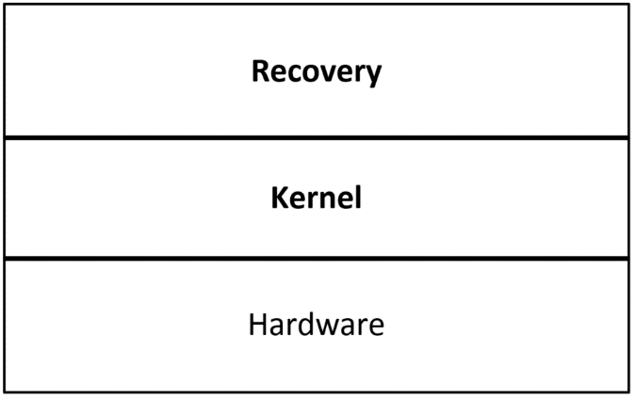
Recovery
Recovery is a tool that can be used to upgrade or reinstall Android systems.
It is part of the AOSP source code, The source code for recovery can be found at $AOSP/bootable/recovery.
The unique point about recovery compared to the other parts of Android is that it is a self-contained system by itself.
We can look at recovery using the following diagram, and compare it to the Android and Brillo architectures that we talked about before:
Notes:
In this lesson, we want to have a brief look at recovery as well, since we have three lessons about it in the second part of this course.
Recovery is a separate system from Android that shares the same kernel with the Android system that it supports. We can treat it as a mini operating system or an embedded application that we can find in many embedded devices. It is a dedicated application running on top of the same Linux kernel as Android and it performs a single task, which is to update the current Android system.

Slide 15
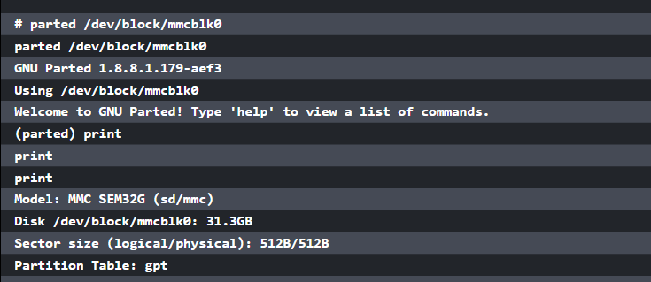
Recovery
Notes:
When the system boots to recovery mode, it boots from a dedicated partition in the flash. This partition includes the recovery image that includes a Linux kernel and a special ramdisk image. If we look at Nexus 5 partitions, we will see the following list:

Slide 16
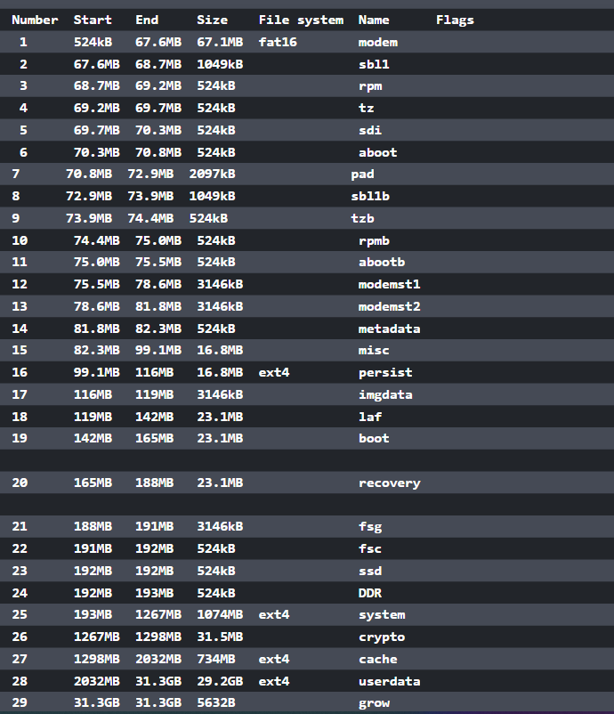
Notes:
The list includes 29 partitions and recovery partition is one of them. The recovery ramdisk of recovery, it has a similar directory structure to the normal ramdisk. In the init script of recovery ramdisk, init starts the recovery program and it is the main process of the recovery mode. The recovery itself is the same as other native daemons in the Android system. The programming for recovery is part of the scope of Android system programming. The programming language and debug method for recovery is also the same as native Android applications. We will discuss this in more depth in the second part of this course.

Slide 17
The third-party open source
projects derived from AOSP
As we know, AOSP source code is the major source that we can start to work with in system-level programming.
Various silicon vendors usually work with Google to enable their reference platforms.
This is a huge effort and they won't publish everything to the world except for their customers.
Notes:
This brings a limitation to the open source world. Since the AOSP source code is mainly for Google devices, such as emulator, Nexus, or Pixel series, there is no problem for developers who use Nexus devices as hardware reference platforms. How about other devices? Manufacturers may release the kernel source code for their devices, but nothing else. In the open source world, several third-party organizations provide solutions for this situation. We will have a brief look at the ones that we used in this course in the following sections.

Slide 18
LineageOS (CyanogenMod)
LineageOS is a community providing aftermarket firmware distribution for many popular Android devices.
It is the successor to the highly popular CyanogenMod.
If you cannot build the ROM for your devices from AOSP source code, you may look at LineageOS source code.
Because there are many devices supported by LineageOS, many major third-party ROM images are built on top of its predecessor CyanogenMod.
Notes:
From the famous MIUI in China to the latest OnePlus device, they all use CyanogenMod source code as the base start from. The major contributions of LineageOS/CyanogenMod to the open source world are the adaptation of the Linux kernel and HAL to various Android devices.
The source code of LineageOS is maintained in GitHub and you can find it at https://github.com/LineageOS.
To build LineageOS source code for your device, the overall build process is similar to the AOSP build. The key difference is the large number of devices supported by LineageOS. For each device, there is a web page to give information about how to build for a device. We use Nexus 5 as an example. You can go to the following page for detailed information:
https://wiki.lineageos.org/devices/hammerhead
In the information page, you can find information about how to download the ROM image, how to install the image, and how to build the image. There is a build guide for devices and we can find the build guide for Nexus 5 at https://wiki.lineageos.org/devices/hammerhead/build.
To build LineageOS for Nexus 5, the two key elements are Kernel and Device. The Kernel includes the Linux kernel and Nexus 5-specific device drivers, while the Device includes the major part of the device-specific HAL code. The naming convention for both the Kernel and Device folder is android_kernel/device_{manufacturer}_{code name}.
The code name for Nexus 5 is hammerhead and the manufacturer is lge, which is LG.
We can find the following two Git repositories for Kernel and Device: https://github.com/LineageOS/android_kernel_lge_hammerhead https://github.com/LineageOS/android_device_lge_hammerhead
Other than the Kernel and Device, other important information is the LineageOS version. You may find it on the same device information page. For Nexus 5, the versions that can be used are 11, 12, 12.1, 13, and 14.1. You may be wondering how to match LineageOS versions to AOSP versions.
The information can be found at the following two pages at Wikipedia about CyanogenMod and LineageOS: https://en.wikipedia.org/wiki/CyanogenMod#Version_history https://en.wikipedia.org/wiki/LineageOS#Version_history
The LineageOS/CyanogenMod and AOSP versions supported for Nexus 5 are CM11 (Android 4.4), CM 12 (Android 5.0), CM 12.1 (Android 5.1), CM 13 (Android 6.0), and CM 14.1 (Android 7.1.1).
You will not be able to access the links related to CyanogenMod while you read this course, since the infrastructure behind CyanogenMod has been shut down recently. You can read the following post to find out more: https://plus.google.com/+CyanogenMod/posts/RYBfQ9rTjEH
Nevertheless, the idea from the preceding configuration is that the key pieces of code to differentiate one device from another are the Kernel and Device. It is possible to share the rest of the code across devices. This is one of the goals for the projects in this course. We try to keep the changes for different hardware platforms within the Kernel and the Device, while keeping the rest of the AOSP source code untouched. This is not 100% possible, but we can try to do it as much as possible. The benefit is that we can keep our code separated from AOSP code and it is much easier to update to a new AOSP version.

Slide 19
Android-x86
While LineageOS/CyanogenMod provides excellent support for a large number of Android devices, many of these devices are ARM-based devices from various silicon vendors, such as Qualcomm, Samsung, MTK, and so on.
Similarly, there is an open source community for Intel-based Android devices as well, This is another famous open source project, Android-x86.
Notes:
Even though the number of Intel x86-based Android devices on the market cannot compare to the number of ARM-based devices, there is another market using the Intel x86 Android build extensively. This is the Android emulator market. For commercial Android emulator products, you can find AMI DuOS, Genymotion, Andy, and so on.
The project Android-x86 uses a very different approach to support various Intel x86-based devices compared to LineageOS/CyanogenMod. Its goal is to provide Board Support Package (BSP) for any Intel x86 devices. It is similar to how you install Microsoft Windows or Linux on your PC. You have only one copy of the release and you can install it on any Intel PCs. There is no special build of Windows or Linux for each different PC or laptop.
To achieve this goal on Android, Android-x86 customized the Android boot up process significantly. There are two stages of boot up process in Android-x86. The first stage is booting up a minimal Linux environment using a special ramdisk--initrd.img. After the system can boot up to this Linux environment, it starts the second stage through the chroot or switch_root command. In this stage, it will boot up the actual Android system.
This is a very smart way to resolve the new challenge using existing technology. Essentially, we try to resolve the problem in two steps. In the first stage of the boot up process, since both Windows and Linux can boot on Intel x86 PCs without a dedicated build, you should be able to boot Linux on an Intel device without too much effort. This is exactly what the first stage of Android-x86 boot up does. After the minimal Linux system can run properly, this means the minimum set of hardware devices is initialized and you are able to debug or boot the rest of the system using this minimal Linux environment. In the second stage, a common Android image for Intel x86 can be started with limited hardware initialization. This approach can be used in the debugging of hardware devices as well. We will show how we can do the same thing on the Android emulator in this course.
The official website of the Android-x86 project is http://www.android-x86.org/. You can find the information about the Android-x86 project there. To build Android-x86, it is a little tricky to get the source code. The original source code was hosted at http://git.android-x86.org and it was maintained by volunteers from Taiwan Linux User Group (TLUG). It was valid for several years. However, it ceased to work from April 2015.
You can always find the latest status from the Google discussion group at https://groups.google.com/forum/#!forum/android-x86. There is an official announcement about the issue of git.android-x86.org at the discussion group from the maintainer Chih-Wei Huang. Later, the hosting was moved to SourceForge for a short period. However, issues retrieving source code from SourceForge have been reported again since July 2016. Currently, the source code is hosted at OSDN and you can search the announcement from Chih-Wei Huang on September 8, 2016 at the Android-x86 discussion group. Since most open source projects are maintained by volunteers, they may be up and down from time to time. It is always good to keep your own mirror of the projects that you work on. We will discuss this issue in this course as well so that you can have full control of your own work.
We know that many open source projects are related to each other and this is true for both Android-x86 and LineageOS/CyanogenMod as well. Starting from January 2016, Jaap Jan Meijer did the initial porting of CyanogenMod to Android-x86 and this makes CyanogenMod available on most Intel devices. If you are interested in this topic, you can search for CM porting plan in the Android-x86 discussion group.

Slide 20
CWM/CMR/TWRP
The original recovery from AOSP only supports very limited functionalities so there are many third-party recovery projects.
ClockworkMod recovery (CWM) is one of the famous open source recovery projects, written by Koushik Dutta.
Even though many people still use ClockworkMod recovery now, this project ceased development some time ago.
Notes:
As a part of system-level programming, we introduced recovery in the previous section.
Another recovery project is CyanogenMod recovery (CMR). CMR is maintained by the CyanogenMod team and it is quite similar to ClockworkMod recovery.
TWRP or TeamWin Recovery Project is another very widely used custom recovery. It is fully touch-driven and has one of the most complete feature sets available. TWRP is the default recovery of OmniROM and its source code is hosted in GitHub as part of OmniROM at https://github.com/omnirom/android_bootable_recovery/.

Slide 21
Strategy of integration
In this course, we will use the AOSP source code as the foundation and try to build everything on top of it, However, we may not be able to rely on AOSP source code only.
In fact, we want to demonstrate how to support a platform that is not supported by AOSP. How are we going to do this? Do we create something from scratch? The answer is no.
Notes:
In the preceding sections, we talked about Android architecture, AOSP, and third-party open source projects for Android. The software industry has been there for decades. There are so many existing source codes that can be reused and the need to create something from scratch is very rare. The porting and customization for a new platform is basically art of integration.
We will demonstrate how we can integrate all existing projects together to create a new platform. That's the reason why we discuss third-party open source projects.
In our case, VirtualBox is not supported by AOSP and we are going to enable it using AOSP and Android-x86. We need to use projects from both AOSP and Android-x86 to build a system for VirtualBox. However, our goal is to create a new build system for VirtualBox with minimal changes to the AOSP source code tree. This is also the goal of many other projects based on AOSP.
Based on the previous understanding, we have four categories of projects in our integration process:
The original unmodified AOSP projects: In these kinds of projects, we will use AOSP projects without any changes.
The third-party projects: In this category, the projects are added by the third-party projects and are not part of AOSP, so there are no changes involved as well.
Projects modified by both AOSP and one of the third-party projects: This is complicated. We need to review the third-party changes and decide whether we want to include them in our system or not.
Projects modified by multiple open source projects and AOSP: This is the most complicated case that we should avoid to integrate or change.
It is very easy to understand that we should try to reuse projects in category 1 and 2 as much as possible. The challenges and major work will be in category 3, while we should try to avoid category 4 whenever possible.

Slide 22
Virtual hardware reference platforms
The new Android releases usually come with two reference platforms.
Developers can test the new Android releases on Android emulator first.
This can be very useful in the preview stages.
After the official release, the Google hardware platforms, such as Nexus or Pixel, usually become the devices for developers.
The emulator and Nexus/Pixel builds are the earliest builds available in AOSP.
Notes:
In this course, we will use Android emulator as the virtual hardware reference platform for our topics. Since the Android emulator build is already available in AOSP, you may wonder what we can do with it. Actually, we can customize an existing platform by adding new features to it. This is what OEM/ODM companies usually do using a reference platform from a silicon vendor. With Android emulator, we will demonstrate how to create a new device so that we can customize it. If you know any commercial emulator products, such as Genymotion and AMI DuOS, then you may know what features these products added to the emulator. We will extend Android emulator in a very similar way.
After we explore the topics about the customization of a new device, we will explore more advanced topics about porting. The major work with porting is the changes to the kernel and HAL. To discuss advanced topics about porting and debugging, we will also use VirtualBox as another virtual hardware reference platform. Even though VirtualBox has been used by many commercial emulator products, such as Genymotion, AMI DuOS, Leapdroid, and so on, it is not supported by AOSP directly. Most Android emulators for the PC are based on VirtualBox and they are designed for gamers to run Android games. In this course, we will learn how to create a similar build using various open source resources.

Slide 23
Introduction to the x86-based Android emulator
Android emulator has been changed dramatically as well in Android 4, 5, 6, and 7.
Before Android 5, Android emulator was built on a virtual hardware reference board called goldfish.
The goldfish virtual hardware platform was built on QEMU 1.x to emulate ARM devices on the x86 environment.
Notes:
The hardware specification of the goldfish virtual hardware platform can be found in the AOSP source tree at $AOSP/platform/external/qemu/docs/GOLDFISH-VIRTUAL-HARDWARE.TXT. In this course, we will refer to the AOSP root directory as $AOSP.
The x86 host environments could be a Windows, Linux, or macOS X computer. Since the target device architecture is emulated using QEMU, the performance is poor. The emulator is very slow and difficult to use for application developers. However, QEMU is actively developed on the x86 architecture and widely used together with various virtualization technologies, such as VT-x, AMD-V, and so on.
Since Android 4.x, Intel developed an x86-based Android emulator using KVM on Linux and Intel HAXM for Windows and macOS X. With the introduction of virtualization technology to the emulator, the Intel x86-based emulator is much faster than the emulated one for the ARM or MIPS architecture. For the sake of Android application developers, Google officially integrated the Intel x86-based Android emulator to Android SDK. The Intel x86-based Android emulator has become the recommended choice for developers to test their Android applications.

Slide 24
Introduction to ranchu
With the introduction of Android 5 (Lollipop), the 64-bit hardware architecture is available for both ARM and Intel platforms.
However, 64-bit hardware devices for Android were still under development at that time.
The only choice for developers was to get a hardware reference platform from silicon vendors.
Notes:
To help developers test their applications on 64-bit architecture, the engineers at Linaro did an excellent job enabling a virtual hardware platform on QEMU to test ARMv8-A 64-bit architecture. They gave this virtual hardware platform a code name, ranchu. You may refer to the blog at Linaro by Alex Bennée at https://www.linaro.org/blog/core-dump/running-64bit-android-l-qemu/.
This change was adopted by Google later and was used as the hardware reference platform for the next generation of Android emulators. If you install the Android SDK images, you can see two kernel images starting from Android 5. The kernel image kernel-qemu is the image to be used with the goldfish virtual hardware platform and the image kernel-ranchu is the image to be used with the ranchu virtual hardware platform.
To respond to this change, both Intel and MIPS worked on their architectures to support their 64-bit hardware emulation in ranchu. You can refer to the group discussions at https://groups.google.com/forum/#!topic/android-emulator-dev/dltBnUW_HzU.
The ranchu hardware platform is based on a newer QEMU version and the architecture is changed to have less dependency on Google modification and goldfish-specific devices. For example, it uses virtio-block devices to emulate the NAND and SD card. This has the potential of providing much better performance and also makes it possible to utilize the features provided by the latest QEMU code base. The ranchu kernel is built on a new version in the android-goldfish-3.10 branch, while the latest goldfish kernel is in the android-goldfish-3.4 branch. You can notice this difference by running your Android virtual device using different kernels from Android SDK.

Slide 25
VirtualBox-based Android emulators
With the ever evolving nature of virtualization technology, there are many commercial Android emulator products developed on the market as well.
You may have heard of some of them such as Genymotion, AMIDuOS, Andy, BlueStacks, and so on. Many of them are built using VirtualBox from Oracle, such as Genymotion, AMIDuOS, and Andy.
The reason that VirtualBox is used instead of other solutions such as VMware is because VirtualBox is an open source solution.
Notes:
To achieve the best performance and user experience, both host and target need to be customized in the commercial emulator products. Besides Android emulator, we will also use VirtualBox as the virtual hardware platform to demonstrate how to port Android to a new platform. The reason that we need another virtual hardware platform in this course is because Android emulator is already supported in AOSP. We will use Android emulator as a platform to teach how to extend and customize an existing platform. While VirtualBox is not supported in AOSP, it can be used as a target platform to teach how to port Android to a new platform. Even though Android has been ported to VirtualBox by Genymotion, AMI, and others, none of them are open source products.

Slide 26
Summary
In this lesson, we discussed what Android system programming is and the scope involved in system-level programming in this course.
After that, we took an overview of the Android system architecture and talked about the layers that we will focus on in this course.
We also discussed the virtual hardware platforms that we use in this course.
Notes:
In this course, we use the code from various third-party projects, so we also took a brief overview of each of them in this lesson. In the next lesson, we will start to learn about the development environment setup for Android system programming. This includes both development tools and the source code repository setup.

Slide 27

"Complete Lab"

Slide 28
Setting Up the Development Environment

Slide 29
Setting Up the Development Environment
We will cover the following topics in this lesson:
Installing the Android SDK and setting up an Android Virtual Device
Setting up the AOSP build environment and building a testing image
Creating your own source code repository mirror
Notes:
After the introduction about system programming in the last lesson, we need to set up a development environment first before we can go further. We need to know how to build and test Android Open Source Project (AOSP) while we explore various Android system programming topics in this course.

Slide 30
Summary of Android versions
Since we will use Android emulator as one of the virtual hardware platforms, we need to use one particular Android version throughout this course.
At the time of writing, the latest Android version is Android 7 (Nougat).
We will use Android 7 throughout the course, I started work on this course with Android 6, so the source code for Android 6 is also available in my GitHub repository at https://github.com/shugaoye.
Notes:
From the first release to Android 7, both the development environment and the AOSP source code have been changed a lot. We will have a brief look at various Android versions first before we talk about the development environment setup.
To set up the AOSP build environment, there are two things that you need to pay special attention to the host environment and Java SDK. Even though the recommended host environment is Ubuntu running on Intel architecture, the hardware architecture and Ubuntu versions have changed from release to release. You can always refer to the following URL at Google for the latest AOSP build environment setup:
https://source.android.com/source/index.html
For Gingerbread (2.3.x) and above, a 64-bit build environment is required. For older versions, the build environment is 32-bit systems.
The Ubuntu versions used range from Ubuntu 10.04 to 14.04, but for each release there is a recommended Ubuntu version. If it is a new setup, it is suggested to use the recommended Ubuntu version to make the job easier. However, there are no hard requirements here. You should be able to use any Ubuntu version higher than the recommended Ubuntu version. There are also many articles about how to set up the AOSP build using a different Linux distribution such as RedHat or Debain.
Oracle JDK was used to build AOSP until Lollipop. From Lollipop and the above, OpenJDK was used instead of Oracle JDK.

Slide 31
Installing Android SDK and setting up an Android Virtual Device
Ideally, if you have an AOSP build environment, you can build everything including Android SDK from scratch.
However, it is much more convenient to have an Android SDK installation to help with virtual device creation or running emulator images.
You can always download the latest Android SDK from the following website:
https://developer.android.com/index.html
Notes:
The host environment that we use in this course is Ubuntu 14.04. Download the Android SDK for Linux and decompress it to a folder in your Home directory.
The tools in Android SDK have been changed since API level 25. You may use an older version of Android SDK or the latest Android SDK so I gave the instructions for both cases here.

Slide 32
Creating AVD in an older version of SDK
For the older version of SDK, such as android-sdk_r24.4.1-linux.tgz, it includes all necessary components and we can use it after decompression.
We can find the following contents after decompressing:
$ ls android-sdk-linux
add-ons platforms SDK Readme.txt temp
build-tools platform-tools system-images tools
Notes:
You can add the platform-tools and tools directory to your PATH environment variable.
We will use a virtual device based on API level 25 in this course to test our image.

Slide 33
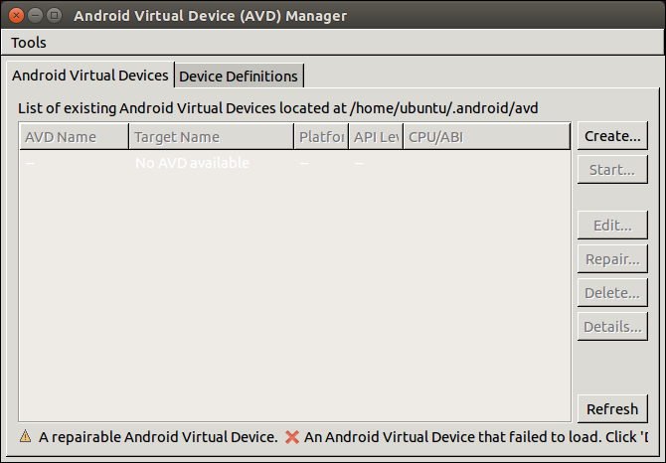
Creating AVD in an older version of SDK
To create a virtual device, we can launch Android Virtual Device (AVD) Manager using the following command, as shown in the following screenshot:
$ android avd

Slide 34
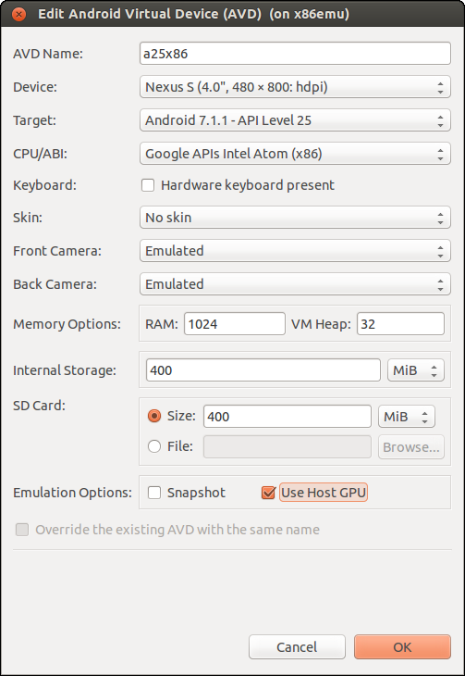
Creating AVD in an older version of SDK
Notes:
Click the Create... button in AVD Manager and create a new virtual device named a25x86 with the following configuration, as shown in the following screenshot:
Android 7.1.1 - API level 25
1024 MB RAM
400 MB SD card
400 MB internal storage
Display size at 480 x 800: hdpi

Slide 35
Creating AVD in the latest version of SDK
For the newer versions, there is only SDK command-line tools available for download.
For example, if you download the command-line tools for r25, such as tools_r25.2.3-linux.zip, you can find the tools folder only.
In this case, you need to use Android SDK Manager at tools/bin/sdkmanager to download the rest of SDK components.
To download the rest of SDK components, you can use the following command:
$ sdkmanager --update

Slide 36
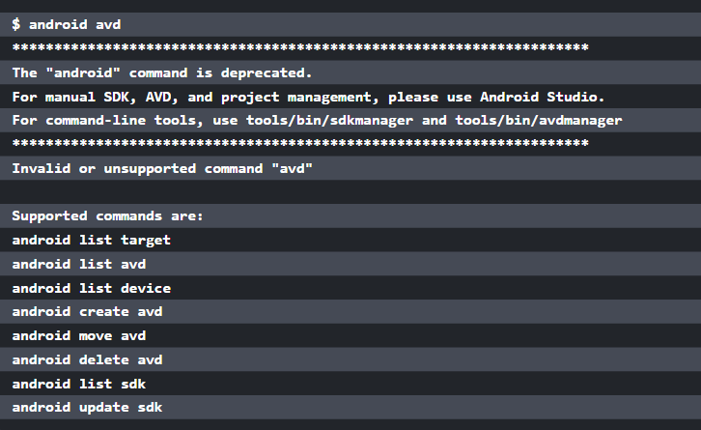
Creating AVD in an older version of SDK
Notes:
If you use the latest version of Android SDK, you may get the following error message, if you follow the previous instructions:

Slide 37
Creating AVD in an older version of SDK
In this case, you can create AVD using the following command.
$ avdmanager create avd -n a25x86 --tag google_apis -k 'system-images;android-25;google_apis;x86'
Auto-selecting single ABI x86
Do you wish to create a custom hardware profile? [no]

Slide 38
Testing the goldfish emulator
$ emulator @a25x86 -verbose -show-kernel -shell -engine classic
emulator:Found AVD name 'a25x86'
emulator:Found AVD target architecture: x86
emulator:Looking for emulator-x86 to emulate 'x86' CPU
...
kernel.path = /home/roger/android-sdk-linux/system-images/android-
25/default/x86/kernel-qemu
...
Notes:
In Android 7, both the ranchu and goldfish emulators are supported. Let's test the goldfish emulator first. We can run this virtual device in the goldfish emulator using the following command:
To monitor the status of a virtual device, we can use the following Android emulator options:
-verbose: Shows the emulator debug information.
-show-kernel: Shows kernel debug information.
-shell: Uses stdio as the command line prompt.
-engine: Selects the emulator engine. The choice can be auto, classic, or qemu2. The classic option is to use the goldfish emulator and the qemu2 option is to use the ranchu emulator. If the option is auto or without the engine option, the system will check the environment and try to launch ranchu first. If it fails, it will fall back to goldfish.
From the preceding log, we can see that the kernel-qemu kernel file is used for the goldfish emulator.

Slide 39
Testing the goldfish emulator
Both the ranchu and goldfish emulators are developed on top of QEMU, but they use different kernel and QEMU versions.
We can verify the QEMU version used for either goldfish or ranchu using the following emulator commands.
To verify the QEMU version used by goldfish, we can run the following command:
$ emulator -engine classic -qemu -version
QEMU PC emulator version 0.10.50 Android, Copyright (c) 2003-2008 Fabrice Bellard
Notes:
From the preceding output, we can see that QEMU version 0.10.50 is used for the goldfish emulator.

Slide 40
Testing the goldfish emulator
For the latest emulator version, it seems there is a bug with regard to handling the classic engine.
You may get the following error message, when you execute the preceding command:
$ emulator -engine classic -qemu -version
emulator: ERROR: android_qemud_get_serial_line: can't create charpipe to serial port
Notes:
The emulator command is a wrapper for QEMU. Any command-line options after -qemu are passed to QEMU as the command lines of QEMU directly. To find out the emulator version, we can use the following command: $ emulator -version The following command will show the QEMU version: $ emulator -qemu -version

Slide 41
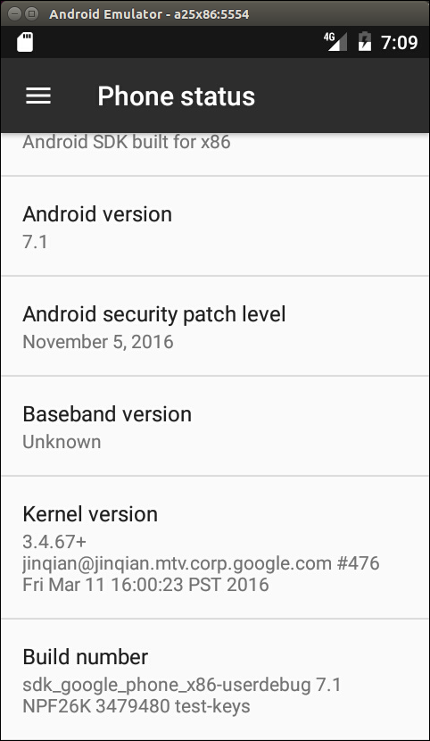
Testing the goldfish emulator
After the Android device has started successfully, from the Android UI, we can go to Settings -> About Phone and see the screen shown in the following screenshot:
Notes:
Pay attention to the following information on the About Phone screen:
Android version: 7.1
Kernel version: 3.4.67
Build number: sdk_google_phone_x86-userdebug 7.1 NPF26K 3479480 test-keys
As we can see from the preceding information, the kernel version is 3.4.67 and the filesystem build number is sdk_google_phone_x86-userdebug 7.1 NPF26K 3479480 test-keys for goldfish emulator. In the next section, we can see that ranchu emulator uses a different kernel version, even though both emulators share the same filesystem.
The Android system build includes two parts: the AOSP system and an Android-compatible Linux kernel. The build result of the AOSP system includes all image files for the Android system except the kernel image. They are built separately and are also under difference licenses. The preferred license for the AOSP is the Apache Software License, while the Linux kernel is under the GPLv2 License. Be aware of this difference. It also means that the AOSP build doesn't include the kernel build. We have to build the kernel separately. We can also use different kernel images with the same filesystem as in the test of the goldfish and ranchu emulator.
When we talk about the Android version, we have to look into the details of the kernel version and filesystem build number.

Slide 42
Testing ranchu emulator
$ emulator @a25x86 -verbose -show-kernel -shell
emulator:Found AVD name 'a25x86'
emulator:Found AVD target architecture: x86
emulator: Found directory: /home/roger/android-sdk-linux/system-images/android-25/default/x86/
emulator:Probing for /home/roger/android-sdk-linux/system-images/android-25/default/x86//kernel-ranchu: file exists
emulator:Auto-config: -engine qemu2 (based on configuration)
emulator:Found target-specific 64-bit emulator binary: /home/roger/android-sdk-linux/tools/qemu/linux-x86_64/qemu-system-i386
...
Notes:
We can test ranchu emulator as well with the same virtual device. We can use a similar command without the -engine option or with the -engine qemu2 option to start ranchu emulator:

Slide 43
Testing ranchu emulator
From the preceding log, we can see that the kernel file kernel-ranchu is used in ranchu emulator.
We can also verify the QEMU version used by ranchu emulator using the following command:
$ emulator -qemu -version
QEMU emulator version 2.2.0 , Copyright (c) 2003-2008 Fabrice Bellard
Notes:
We can see that ranchu uses a much newer QEMU version that can support many new features, which we will discuss later in this course.

Slide 44
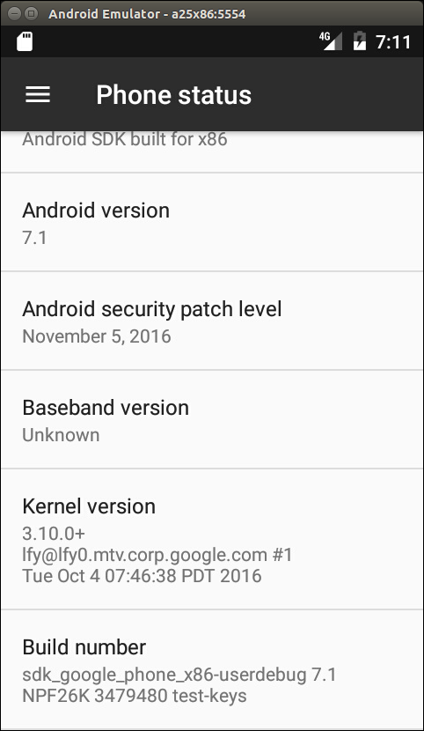
Testing ranchu emulator
Again, let's review the version information in Settings as we did for goldfish emulator; refer to the following screenshot:
Notes:
We can see that the ranchu emulator uses the kernel version 3.10.0, which is different from the goldfish emulator. The filesystem build is the same as for the goldfish emulator.

Slide 45
The AOSP build environment and the Android emulator build
In order to create our own Android system, we have to set up the AOSP build environment and build our own AOSP target for the Android emulator.
Since Android is under rapid development, the build process and environment setup can change from time to time.
You can always refer to Google's website for the latest information, https://source.android.com/source/building.html.
Notes:
While the Google website and other sources can give general guidelines and procedures about the AOSP build, in this section we will look specifically at how to build AOSP for Android emulator image for API level 25.
The AOSP build environment
Since we want to set up a build environment for API level 25, you can refer to the table of AOSP releases for the basic requirements about the host and JDK. It is recommended to use the Ubuntu 14.04 64-bit host with Open JDK 8. For the hardware requirement, you may want to have a powerful enough computer with at least 8 GB RAM and 500 GB hard disk space.

Slide 46
Installing the required packages
If you use a different Linux distribution, you can refer to Google's website or search on the Internet for the relevant setup procedures.
Let's execute the following commands to install all necessary packages for Ubuntu 14.04:
$ sudo apt-get install git-core gnupg flex bison gperf build-essential\
zip curl zlib1g-dev gcc-multilib g++-multilib libc6-dev-i386\
lib32ncurses5-dev x11proto-core-dev libx11-dev lib32z-dev ccache\
libgl1-mesa-dev libxml2-utils xsltproc unzip
Notes:
We use the Ubuntu 14.04 64-bit version as our host operating system. After installing Ubuntu 14.04, the first thing you have to do is to install all necessary software packages as follows.

Slide 47
Installing Open JDK 7 and 8
We will install both Open JDK 7 and 8 so we can build both Android 6 and 7 in our build environment.
To build Android API level 23, we need to install OpenJDK 7.
We can execute the following commands from the Linux console to install OpenJDK 7:
$ sudo apt-get update
$ sudo apt-get install openjdk-7-jdk
Notes:
For Android 7, we need to use OpenJDK 8 to build. There are no available supported OpenJDK 8 packages for Ubuntu 14.04 yet, but the Ubuntu 15.04 OpenJDK 8 packages have been used successfully with Ubuntu 14.04. We need to install OpenJDK 8 on Ubuntu 14.04 using the following instructions.

Slide 48
Installing Open JDK 7 and 8
Download the .deb packages for 64-bit architecture from archive.ubuntu.com:
openjdk-8-jre-headless_8u45-b14-1_amd64.deb with SHA256 0f5aba8db39088283b51e00054813063173a4d8809f70033976f83e214ab56c0
openjdk-8-jre_8u45-b14-1_amd64.deb with SHA256 9ef76c4562d39432b69baf6c18f199707c5c56a5b4566847df908b7d74e15849
openjdk-8-jdk_8u45-b14-1_amd64.deb with SHA256 6e47215cf6205aa829e6a0a64985075bd29d1f428a4006a80c9db371c2fc3c4c
Notes:
Optionally, confirm the checksums of the downloaded files against the SHA256 string listed with each preceding package.

Slide 49
Installing Open JDK 7 and 8
For example, with the sha256sum tool:
$ sha256sum {downloaded.deb file}
Install the packages:
$ sudo apt-get update
Run dpkg for each of the .deb files you downloaded, It may produce errors due to missing dependencies:
$ sudo dpkg -i {downloaded.deb file}

Slide 50
Installing Open JDK 7 and 8
To fix missing dependencies:
$ sudo apt-get -f install
With both OpenJDK 7 and 8 installed, we can update the default Java version by running the following commands:
$ sudo update-alternatives --config java
$ sudo update-alternatives --config javac
Notes:
We have a build environment ready now. You may want to refer to Google's website to set up other things. For example, we may want to use cache to speed up the build or set up a separate output directory out of the AOSP tree.

Slide 51
Downloading the AOSP source
Once we have a build environment ready, we need to get the AOSP source code.
Again, refer to Google's website or the Internet to get more information.
You need to download the Android 7 source code from source.android.com.

Slide 52
Installing repo
AOSP consists of a large number of Git repositories, and we have to use the repo tool to manage these Git repositories.
To download and install repo, we can use the following commands:
$ mkdir ~/bin
$ PATH=~/bin:$PATH
$ curl https://storage.googleapis.com/git-repo-downloads/repo > ~/bin/repo
$ chmod a+x ~/bin/repo

Slide 53
Initializing a repo client and downloading the AOSP source tree
After we have the repo tool, we can initialize the repo and download the AOSP source tree by executing the following commands:
$ repo init -u https://android.googlesource.com/platform/manifest -b android-7.1.1_r4
$ repo sync
Notes:
Pay attention to the AOSP tag android-7.1.1_r4 here. This is the version of AOSP source code that we use throughout this course.

Slide 54
Initializing a repo client and downloading the AOSP source tree
It will take quite a long time to get the AOSP source tree. After we get the source tree, let's take a look at the top level folders:
$ ls -F
abi/ cts/ docs/ libcore/ packages/ tools/
art/ dalvik/ external/ libnativehelper/ pdk/
bionic developers filelist Makefile prebuilts
bootable development frameworks ndk sdk
build device hardware out system
Notes:
Pay attention to the AOSP tag android-7.1.1_r4 here. This is the version of AOSP source code that we use throughout this course.

Slide 55
Creating your own repository mirror
It usually takes a very long time to download the AOSP source code.
After you have downloaded the AOSP source code, you have actually downloaded a specific version of the AOSP source code from the remote repository.
You may have to test different configurations or versions in your development work. It is a very time-consuming task to switch to a different version or create a new copy of the AOSP source code.
Notes:
In this course, we will use the AOSP source code as the base for our development. To reuse some of the existing open source projects that are not included in AOSP, we have to modify the repo manifest from time to time. This involves changing the repo configuration. To work more efficiently, we can use a local mirror. It can save a lot of time to create a local mirror instead of downloading source code from remote repositories for all configuration changes. It may take hours to change a configuration from a remote repository, but it will need just a few minutes with the local repository.
When we work with open source projects, the server to host the project may change from time to time. It is always good to have your own mirror so that we won't rely too much on the remote repositories. With a local mirror, we can still work without too much impact even though the remote server may be not available for a certain period. This is exactly the issue that I face when I try to integrate Android-x86 projects in the later part of this course.
I will explain how to create a mixed local mirror of AOSP, Android-x86, and GitHub in this section.

Slide 56
Repo and manifest
After we run the repo init command as we did in the previous section, a .repo folder is created under the current folder.
If we take a look at the .repo folder, we can see the following contents:
$ ls -F .repo
manifests/ manifests.git/ manifest.xml@ repo/
Notes:
To create and manage repository mirrors, we need to understand the repo command and the directory structure managed by repo a little more. The repo command deals with a XML file manifest and it stores everything in a folder called .repo.
Three folders and a symbolic link are created. The following is an explanation of each:
manifests: This is a working copy of the Git repository of the manifest itself.
manifests.git: This is the Git repository of the manifest. The manifest itself is under the version control using Git.
manifest.xml: This is a symbolic link to the file .repo/manifests/default.xml. This file is the main configuration file used by repo. We will look into the details later.
repo: The repo tool itself is written in the Python language. Python scripts are stored in this folder.

Slide 57
Repo and manifest
After we run the repo init command to initialize the repo data structure, we can run the repo sync command to retrieve a working copy.
If we look at the .repo folder again after the repo sync command, we can see that there are two project related folders created:
$ ls -F .repo
manifests/ manifest.xml@ project-objects/ repo/
manifests.git/ project.list projects/
Notes:
The following is an explanation of the newly created file and folders:
project.list: This is a list of all projects downloaded.
project-objects: This is a copy of the remote repository.
projects: This is the repository hierarchy matching the working copy. The path may be rearranged after a repository is copied to local. The contents in this folder are symbolic links to the items in project-objects.

Slide 58
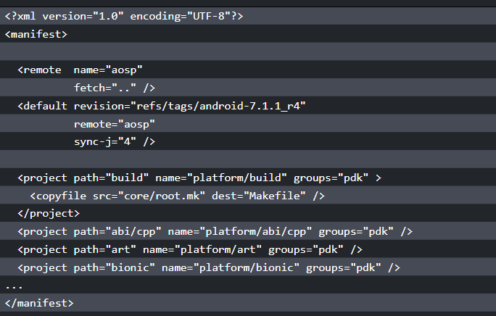
Repo and manifest
Notes:
The most important file in the .repo folder is .repo/manifests/default.xml or its symbolic link manifest.xml. The detailed specification of this file can be found in the document under the .repo folder at .repo/repo/docs/manifest-format.txt. We won't go into any details, but let's take look at the most commonly used elements.
In the preceding code snippet, we can see that there are three XML elements inside manifest:
remote: The remote element provides the details about remote repository. We can give it a name such as aosp. The URL of the remote repository can be specified in the fetch field. It can be a relative path or a full path.
default: There are multiple remote elements that can be specified in manifest. The default element defines which remote is the default one.
project: Each project element defines a Git repository. The path field supplies the local path after it is downloaded. The name field supplies the remote path of the Git repository. The revision field supplies the branch that we want to get and the remote field tells us which remote server we use to get the Git repository.
There are other XML elements that can be used in manifest as well. You can find out what they are by looking at the preceding specification yourself.

Slide 59
Using a local mirror for AOSP
If you refer to the article from the Google website about downloading the source, you can find a section called Using a local mirror.
It reveals that if you need two different configurations of the AOSP build environment, the download for two clients is larger than the size of a full mirror of the repository.
It is very simple to set up a mirror as follows:
$ mkdir -p /usr/local/mirror/aosp
$ cd /usr/local/mirror/aosp
$ repo init -u https://android.googlesource.com/mirror/manifest --mirror
$ repo sync

Slide 60
Using a local mirror for AOSP
After we run the repo init command to initialize the repo data structure, we can run the repo sync command to retrieve a working copy.
If we look at the .repo folder again after the repo sync command, we can see that there are two project related folders created:
$ ls -F .repo
manifests/ manifest.xml@ project-objects/ repo/
manifests.git/ project.list projects/

Slide 61
Using a local mirror for AOSP
<?xml version="1.0" encoding="UTF-8"?>
<manifest>
<remote name="aosp"
fetch=".." />
<default revision="master"
remote="aosp"
sync-j="4" />
<project name="accessories/manifest" />
<project name="brillo/manifest" />
...
</manifest>
Notes:
From the preceding commands, we can see that we actually use a different manifest to create a mirror. If we look at the content of the manifest for a mirror, we can see the following XML code:
We can see that for all projects, there are only the project names without other information in each project item. This is because we actually copy each Git repository to the local as a bare Git repository. We won't check out a working copy, so we don't need to worry about the version.

Slide 62
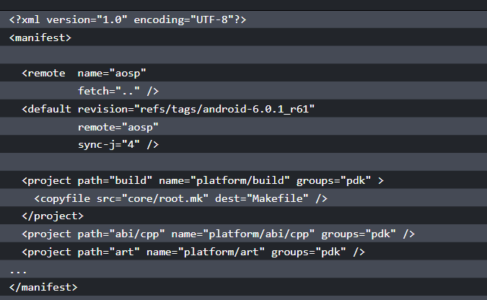
Using a local mirror for AOSP
Notes:
If we look at the manifest to check out a working copy, we will see the following:
It includes more items than the one to create a mirror. The name field specifies the path at the remote repository and the path field specifies the local path after the repository is downloaded to the local. We also need to specify revision that we want to retrieve.

Slide 63
Using a local mirror for AOSP
After we have a mirror, we can check out a copy of the AOSP source from that mirror as follows:
$ mkdir -p $HOME/aosp/master
$ cd $HOME/aosp/master
$ repo init -u /usr/local/mirror/aosp/platform/manifest.git
$ repo sync
Notes:
If you need, you can check out multiple copies from the local mirror. No matter if you check out multiple copies or you change to a different version, you can save a lot of time compared to checking out from a remote repository.
When you work on a system-level project, you may need projects out of the AOSP source. For example, in this course, we use multiple projects from CyanogenMod, Android-x86, and my own projects in GitHub. In this case, we can actually create our own manifest to mix all projects that we need together from our local mirror. Our local mirror will become a superset of the public mirror. We can create branches and tags from time to time in local repositories, but we only push the baselines that we want to release to the public repositories. This is exactly what the Google development team does in their private repositories.

Slide 64
Summary
In this lesson, we set up the environment for SDK and AOSP. We built the Android emulator images for AOSP. We also tested and compared the Android images in Android SDK and AOSP.
All these steps are necessary before we continue exploring how to create our own Android system later.
Notes:
We also spent some time discussing how to set up our own repo mirror. This tip can help us later, when we start to create projects from multiple open source projects. In the next lesson, we will start to explore the architecture of Android. We will look into the details of layers related to the porting and customization of the Android system.

Slide 65
Discovering Kernel, HAL, and Virtual Hardware

Slide 66
Discovering Kernel, HAL, and Virtual Hardware
In this lesson, we will cover the following topics:
Deep analysis of Android HAL using the goldfish lights service
Review the hardware specification for goldfish
Overview about QEMU pipe implementation in the goldfish kernel
Notes:
Once we set up the development environment and get the source code ready to use. We can start to explore the Android system architecture in more depth. We will look at the AOSP source tree first. After that, we will study the virtual hardware platforms that we are going to use in this course. Based on our understanding of the virtual hardware, we will look at the layers related to the system customization.

Slide 67
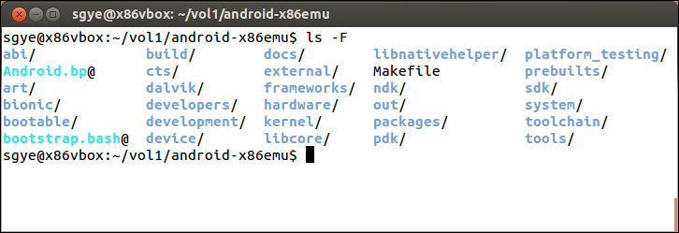
What is inside the AOSP?
Before we move to the details, let's take a look at the top level of the AOSP source code tree again:

Slide 68
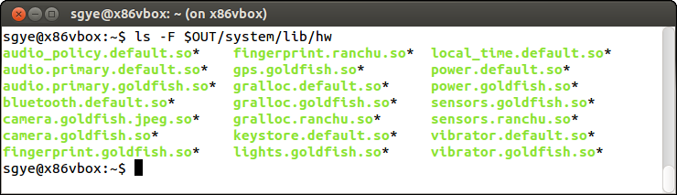
Android emulator HAL
We built the Android emulator in lesson 2, Setting Up the Development Environment.
In order to have an overview of Android emulator HAL, we can take a look at the $OUT/system/lib/hw folder as follows:
Notes:
Usually, the HAL implementation is a shared library and it will be loaded by system service at runtime. It actually depends on the complexity of the hardware itself when it comes to deciding the actual implementation. For example, there is no separate shared library for simple hardware such as serial ports. The system service implementation of a serial port accesses the device node directly.
For more complicated hardware devices, such as graphics, there is a dedicated daemon SurfaceFlinger running in the background as well as multiple shared libraries associated with it.
In this lesson, we will analyze the HAL of device goldfish lights and use it as an example to understand the relationship between frameworks, system servers, and HAL implementation. After that, we will go through the hardware interface for goldfish devices. Finally, we will analyze the QEMU pipe implementation in the goldfish kernel.

Slide 69
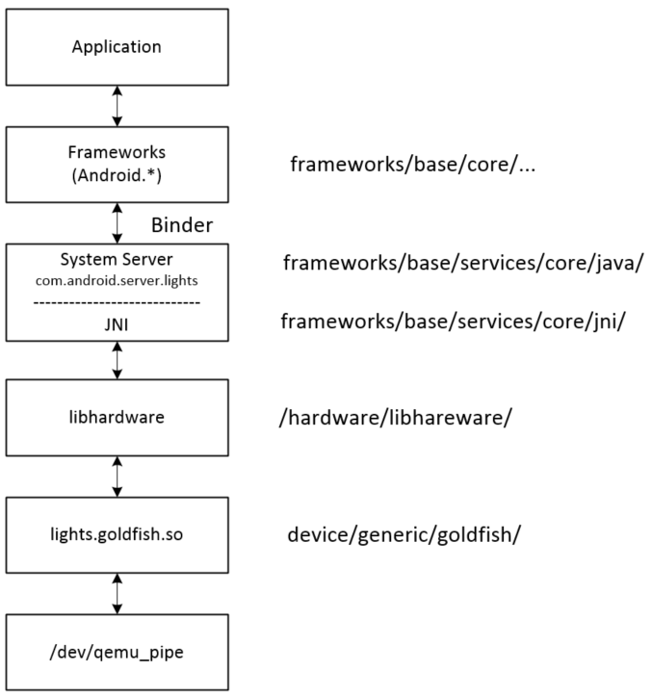
Calling sequence
We will use the lights hardware interface as an example to explain how HAL, system services, and hardware managers work together.

Slide 70
Calling sequence
When an application wants to access hardware resources, it has to get an instance of the hardware manager first.
For goldfish lights, the code in the application may look as follows:
LightsManager lights =
LocalServices.getService(LightsManager.class);
mBacklight = lights.getLight(LightsManager.LIGHT_ID_BACKLIGHT);
mBacklight.setBrightness(brightness);
Notes:
The hardware manager talks to the system service to get hardware access. Usually, the hardware manager is implemented in Java. It calls to the system service using a binder interface since the hardware manager and system service run in different process spaces. The upper layer of the system service also implements in Java. After the system service gets the request, it will call to HAL library using JNI since the HAL is implemented using C or C++ usually.

Slide 71
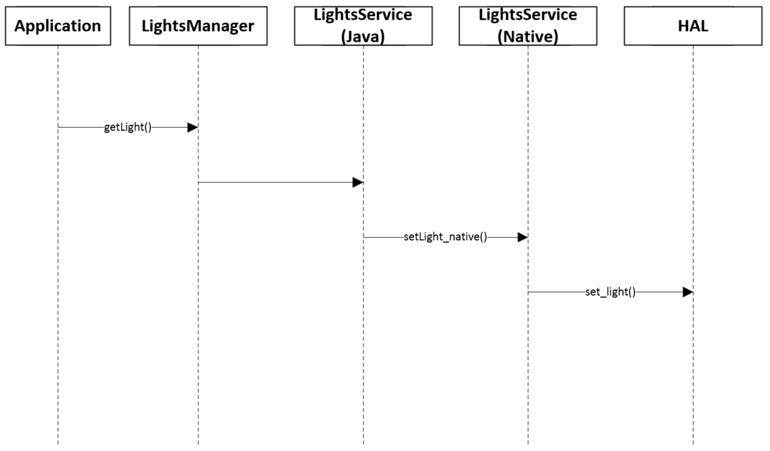
Calling sequence
Notes:
The preceding figure shows the calling sequence when an application wants to change the light on the device. We will use a bottom-up approach in this section to look at the calling sequence from HAL to the application layer.

Slide 72
Goldfish lights HAL
The goldfish lights HAL implementation can be found in the $AOSP/device/generic/goldfish/lights folder.
To implement the HAL layer, the hardware vendor usually needs to implement the following three data structures:
struct hw_module_t;
struct hw_module_methods_t;
struct hw_device_t;

Slide 73
Goldfish lights HAL
/*
* The emulator lights Module
*/
struct hw_module_t HAL_MODULE_INFO_SYM = {
.tag = HARDWARE_MODULE_TAG,
.version_major = 1,
.version_minor = 0,
.id = LIGHTS_HARDWARE_MODULE_ID,
.name = "Goldfish lights Module",
.author = "The Android Open Source Project",
.methods = &lights_module_methods,
};
Notes:
All the preceding three data structures are implemented in the lights_qemu.c file for goldfish. In the HAL implementation, we need to define struct hw_module_t named HAL_MODULE_INFO_SYM first as follows. This registers the hardware module ID LIGHTS_HARDWARE_MODULE_ID in the system. After this, lights system service can get the module using the hw_get_module function:

Slide 74
Goldfish lights HAL
You may notice that the method field has a pointer of lights_module_methods inside the preceding data structure.
It is defined as follows:
static struct hw_module_methods_t lights_module_methods = {
.open = open_lights,
};
Notes:
This defines the second HAL data structure hw_module_methods_t. Inside this data structure, it defines an open_lights method, which is the HAL function to initialize the hardware.

Slide 75
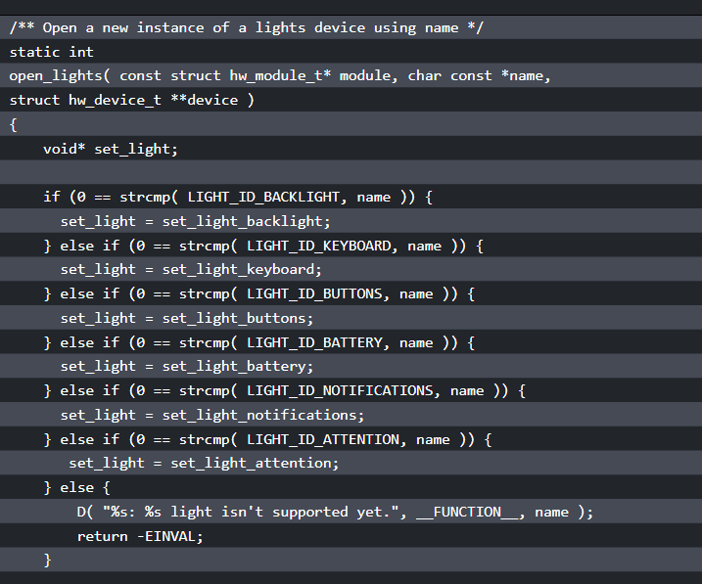
Goldfish lights HAL
Notes:
Let's take a look at this function as follows:

Slide 76
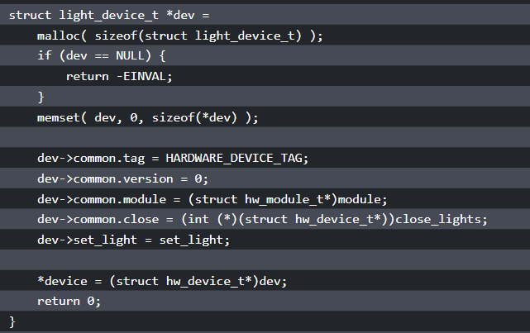
Goldfish lights HAL
Notes:
Inside open_lights, it allocates the memory for the light_device_t data structure, which inherits the third HAL data structure, hw_device_t. When it initializing the data structure light_device_t, it registers two functions, close_lights and set_light, so the system service can call these functions to change the light or close the device. The function pointer set_light is set to a specific function according to the type of light.

Slide 77
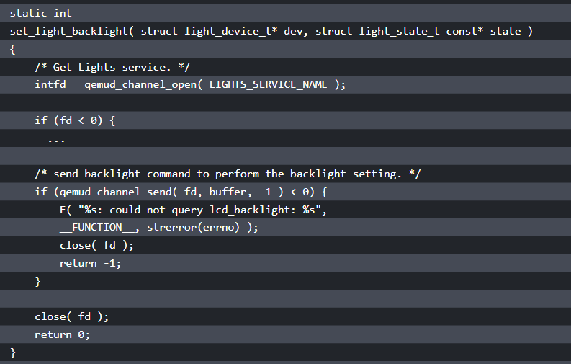
Notes:
Inside each set_light_xxx function, it talks to the kernel space through the QEMU pipe device /dev/qemu_pipe. For example, we can take a look at set_light_backlight:
Inside the set_light_backlight function, it calls qemud_channel_open and qemud_channel_send to do the actual work. Both functions use the QEMU pipe device /dev/qemu_pipe eventually.

Slide 78
The system service and hardware manager
To analyze how the application accesses light hardware, refer to the figure of the lights service calling sequence.
In an application, what calls the getService(LightsManager.class) function to get an instance of LightsManager as follows:
LightsManager lights =
LocalServices.getService(LightsManager.class);
mBacklight = lights.getLight(LightsManager.LIGHT_ID_BACKLIGHT);
Notes:
Usually the hardware manager and system service are implemented in different processes for most hardware interfaces. However, the hardware of the light is so simple, so both the system service and hardware manager are implemented in the same process.
The system service includes two parts: Java and JNI. The JNI implementation can be found at frameworks/base/services/core/jni, while the Java implementation can be found at frameworks/base/services/core/java/com/android/server. Both LightsManager and LightsService are implemented in frameworks/base/services/core/java/com/android/server/lights.

Slide 79
The system service and hardware manager
There are three files in this folder as follows.
They implement both LightsManager and LightsService:
$ ls
Light.java LightsManager.java LightsService.java
Notes:
Usually the hardware manager and system service are implemented in different processes for most hardware interfaces. However, the hardware of the light is so simple, so both the system service and hardware manager are implemented in the same process.
The system service includes two parts: Java and JNI. The JNI implementation can be found at frameworks/base/services/core/jni, while the Java implementation can be found at frameworks/base/services/core/java/com/android/server. Both LightsManager and LightsService are implemented in frameworks/base/services/core/java/com/android/server/lights.

Slide 80
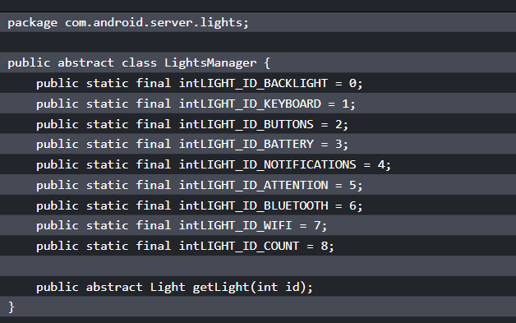
The system service and hardware manager
Notes:
Let's look at LightsManager first. We can see from the following snippet that LightsManager only returns an abstract class, Light, to the caller:

Slide 81
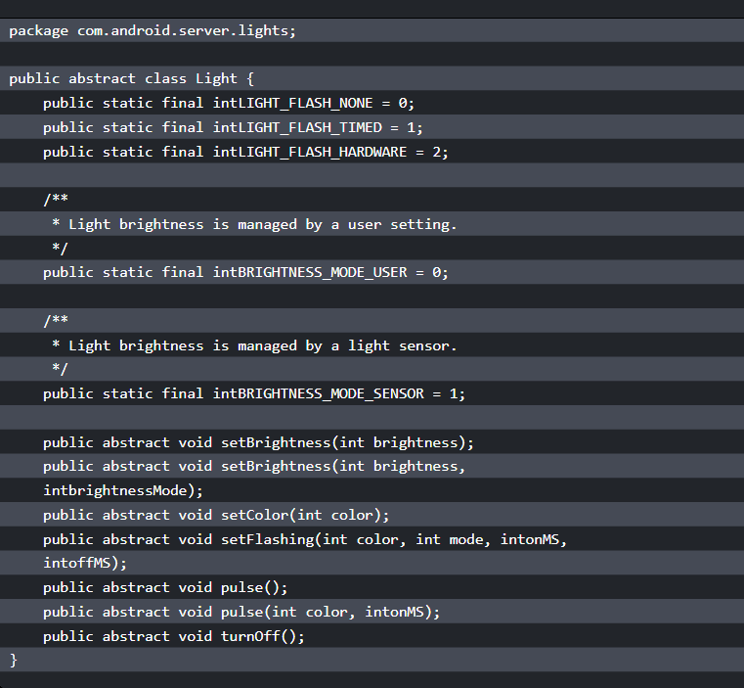
Notes:
Let's follow the code to look at the abstract class Light. In the abstract class Light, it defines a list of functions that have to be implemented for Light. These functions are implemented in the LightsService class:

Slide 82
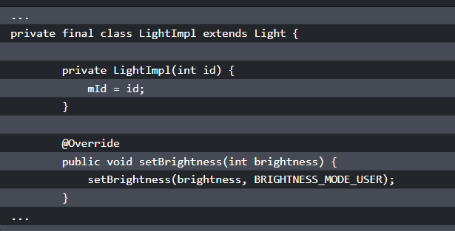
The system service and hardware manager
Notes:
In LightsService.java in the following snippet, it implements the list of functions defined by the Light class:
This set of functions in the abstract class Light calls a setLightLocked function to do the actual work.

Slide 83
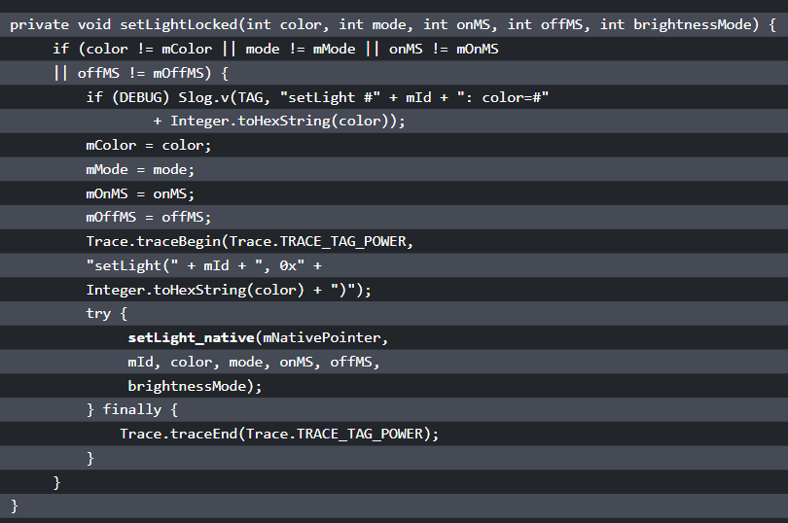
Notes:
In this function, it calls a native function, setLight_native, to invoke the native part of LightsService:

Slide 84
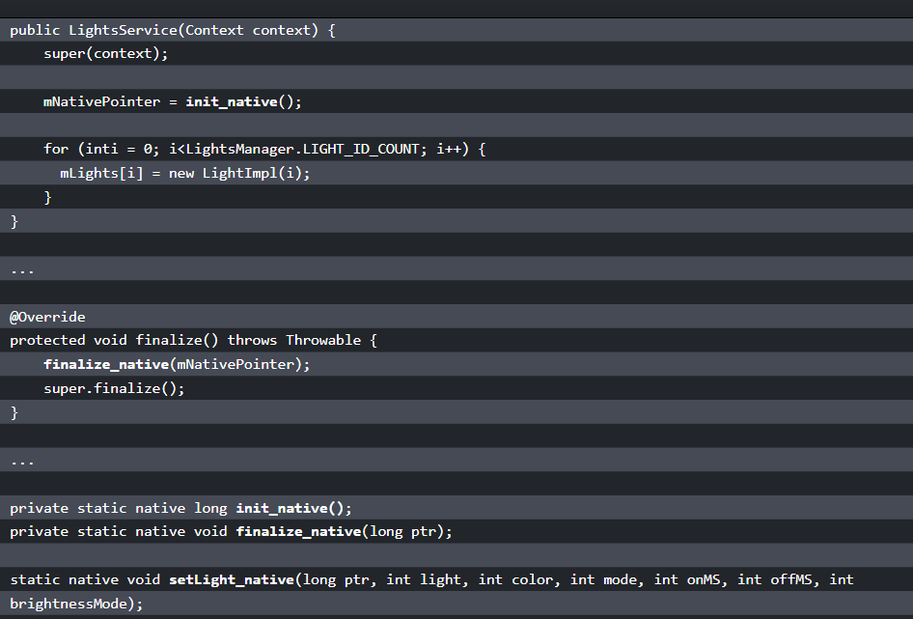
Notes:
Besides setLight_native, LightService also calls two more native functions, init_native and finalize_native. We can see this in the following code snippet. These two functions call to the HAL layer functions, as we discussed in the previous section:

Slide 85
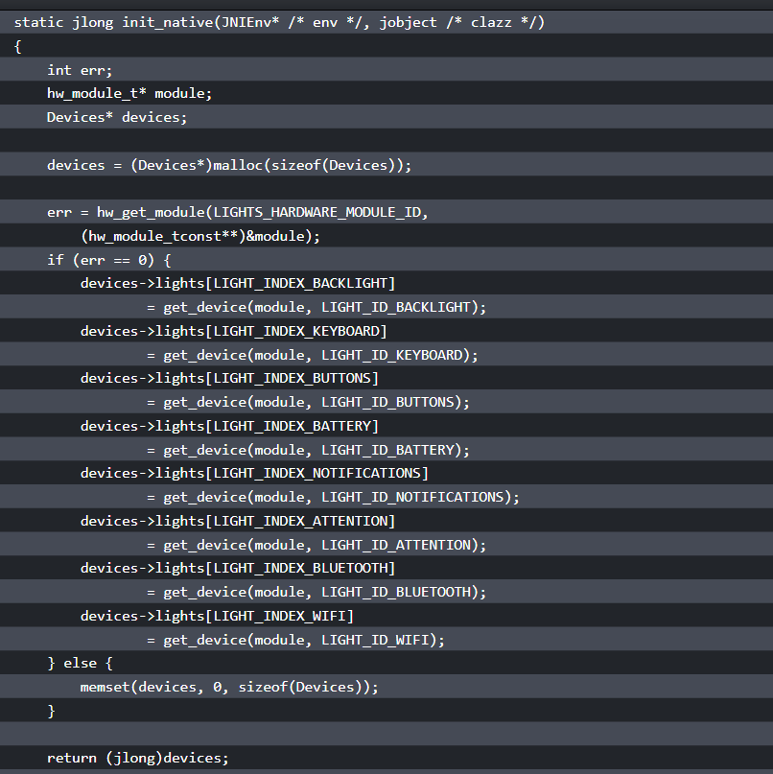
Notes:
We have looked at the implementation of LightsManager and the Java implementation of LightsService. Now let's explore the JNI part of the LightsService implementation. The JNI part is implemented in com_android_server_lights_LightsService.cpp, which can be found in the $AOSP/frameworks/base/services/core/jni folder. We will look at how these three native functions used in LightsService are connected to the HAL layer:

Slide 86
The system service and hardware manager
static light_device_t* get_device(hw_module_t* module, char const* name)
{
int err;
hw_device_t* device;
err = module->methods->open(module, name, &device);
if (err == 0) {
return (light_device_t*)device;
} else {
return NULL;
}
}
Notes:
In the init_native function, it calls the hw_get_module function to get the light HAL module using LIGHTS_HARDWARE_MODULE_ID as the hardware ID. If you look back, it is defined in the HAL. This function loads the shared library of HAL implementations. In this case, it loads lights.goldfish.so. After loading the shared library, it calls get_device to initialize all the light devices. We can see the implementation of get_device in the following snippet:
In get_device, it invokes the open method and gets the instance of HAL data structure hw_device_t. We discussed the open method in the goldfish lights HAL.

Slide 87
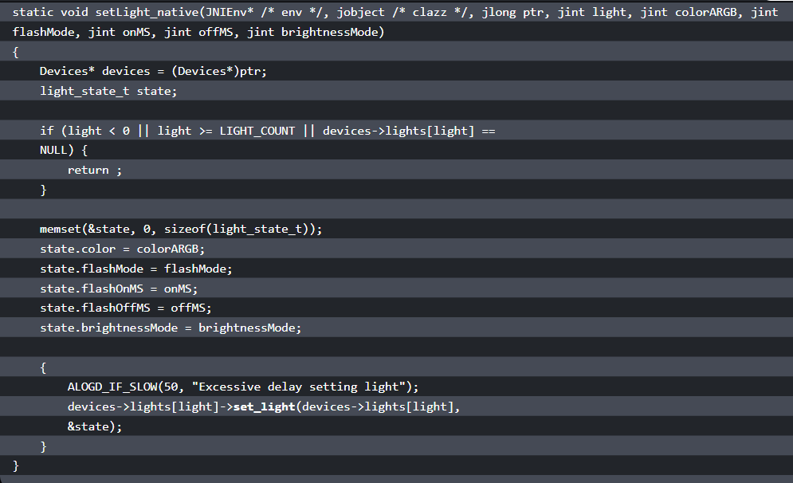
What is inside the AOSP?
Notes:
Now let's look at another native function, setLight_native:
In the setLight_native function, it gets the pointer of the data structure Devices first. After that, it calls the HAL function set_light to do the actual work.

Slide 88
The system service and hardware manager
Finally, let's look at the implementation of the native method, finalize_native:
static void finalize_native(JNIEnv* /* env */, jobject /* clazz */, jlong ptr)
{
Devices* devices = (Devices*)ptr;
if (devices == NULL) {
return;
}
free(devices);
}
Notes:
We can see that the finalize_native function just frees all resources used.

Slide 89
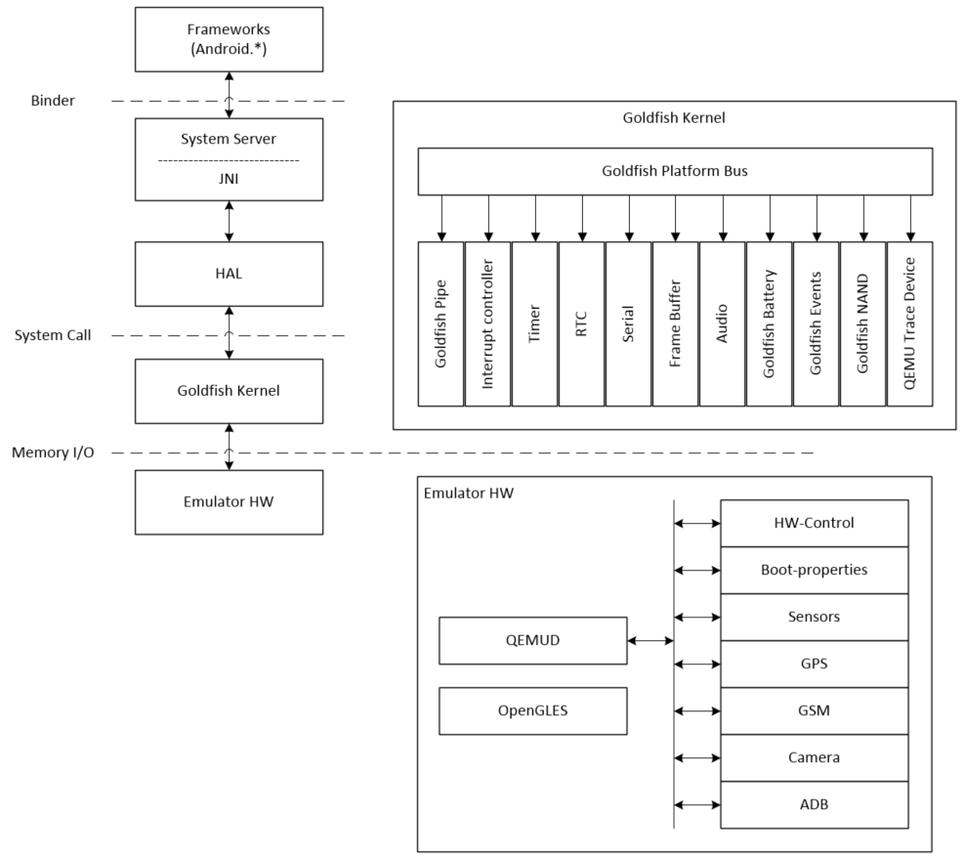
Android emulator kernel and hardware
Notes:
We use goldfish lights as an example to perform the calling sequence analysis from an application to the goldfish HAL. Now we can look at the kernel layer and the underlying hardware. We can also take an overview from the top to the bottom again to understand how the entire system works.
We use the preceding figure to explain goldfish kernel and hardware in detail. As you can see, the preceding figure is similar to the architecture diagram that we saw in lesson 1, Introduction to Android System Programming. This architecture diagram is the general architecture diagram for Android, but the preceding figure is specific to goldfish.
From the diagram, we can see the parts that we are interested in the goldfish kernel and emulator hardware. From the top to the bottom, the application utilizes the Android framework to implement functionalities and access the hardware. The framework usually resides in a different process from the system service layer, so they use Binder IPC to communicate with each other. The system service talks to the HAL using JNI, since HAL usually implements in the native language. The HAL is the user space implementation of hardware control and it communicates to the device driver in the kernel space through system calls. In the case of the goldfish hardware, the device driver accesses the virtual hardware through memory I/O registers, as we will see in the following section on Android emulator hardware.

Slide 90
Android emulator hardware
Unlike real hardware, most Android emulator hardware interfaces are emulated using QEMU, which is a popular open source emulator engine used by many open source projects.
The Android development team customized QEMU and added a virtual hardware platform called goldfish.
Notes:
As we mentioned in lesson 2, Setting Up the Development Environment, there are currently two versions of Android emulator available in the latest SDK.
The code name for the original Android emulator is goldfish and the new one is ranchu. However, the virtual hardware code base for device emulation in QEMU is the same for both versions.
Detailed information about goldfish hardware interfaces can be found in the document GOLDFISH-VIRTUAL-HARDWARE.TXT. This document can be found in the AOSP source code at $AOSP/platform/external/qemu/docs/GOLDFISH-VIRTUAL-HARDWARE.TXT.
For different kernel versions, the hardware interfaces may have some differences. In this course, we will look at the Intel x86-based ranchu virtual hardware, which uses Android Linux version 3.10.0. Let's look at the goldfish devices that we will discuss in this lesson.

Slide 91
Goldfish platform bus
In the architecture diagram for goldfish, we have a detailed diagram for the kernel and goldfish hardware.
We can see that all goldfish devices are enumerated through the goldfish platform bus.
The platform bus is a special device that is capable of enumerating other platform devices found on the system to the kernel.
Notes:
This flexibility allows us to customize which virtual devices are available when running a given emulated system configuration. The following table defines goldfish platform bus registers.

Slide 92
QEMU pipe device
One of the most important emulated devices in goldfish hardware is the QEMU pipe device.
This is a special device that is totally specific to QEMU, but allows guest processes to communicate directly with the emulator with extremely high performance.
This is achieved by avoiding any in-kernel memory copies, relying on the fact that QEMU can access guest memory at runtime (under proper conditions controlled by the kernel).
Notes:
As we can see from the goldfish architecture diagram, many other hardware interfaces, such as GPS, sensors, basebands, cameras, and so on, are emulated through the QEMU pipe. The following table defines QEMU pipe device registers.

Slide 93
Goldfish audio device
The goldfish audio device implements a virtual sound card with the following properties:
Stereo output at fixed 44.1 kHz frequency, using signed 16-bit samples, This is mandatory.
Mono input at fixed 8 kHz frequency, using signed 16-bit samples, This is optional.

Slide 94
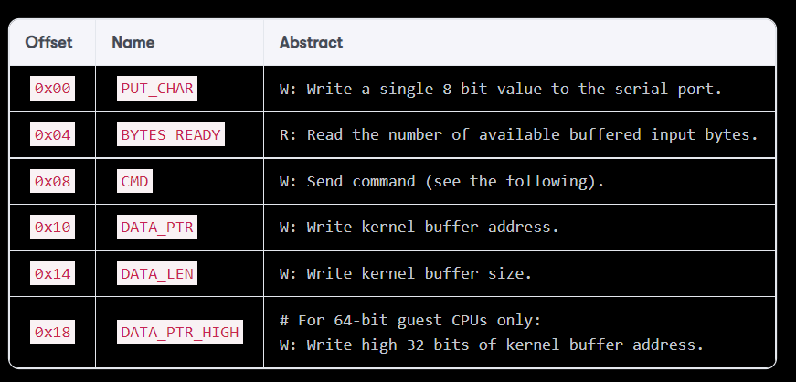
Goldfish serial port
The following table defines goldfish serial port registers:
Notes:
Android emulator has its own implementation of a virtual serial port. It always reserves the first two virtual serial ports:
The first one is used to receive kernel messages. This is done by adding the console=ttyS0 parameter to the kernel command line.
The second one is used to set up the legacy qemud channel, used on older Android platform revisions. This is done by adding android.qemud=ttyS1 on the kernel command line. The qemud channel is implemented as a Linux daemon process used as a channel between the guest and emulator. In the latest emulator version, a QEMU pipe is used instead of qemud.

Slide 95
Goldfish serial port
The CMD I/O register is used to send various commands to the device, identified by the following values:
0x00 CMD_INT_DISABLE Disable device.
0x01 CMD_INT_ENABLE Enable device.
0x02 CMD_WRITE_BUFFER Write buffer from kernel to device.
0x03 CMD_READ_BUFFER Read buffer from device to kernel.
Notes:
Each device instance uses one IRQ, raised to indicate that there is incoming/buffered data to read.

Slide 96
Goldfish kernel
Goldfish kernel can be downloaded from the AOSP source repository.
You can download and build the kernel source code using the following command:
$ git clone https://android.googlesource.com/kernel/goldfish.git
$ cd goldfish
$ git checkout -b android-goldfish-3.10 origin/android-goldfish-3.10
$ make i386_ranchu_defconfig
$ make

Slide 97
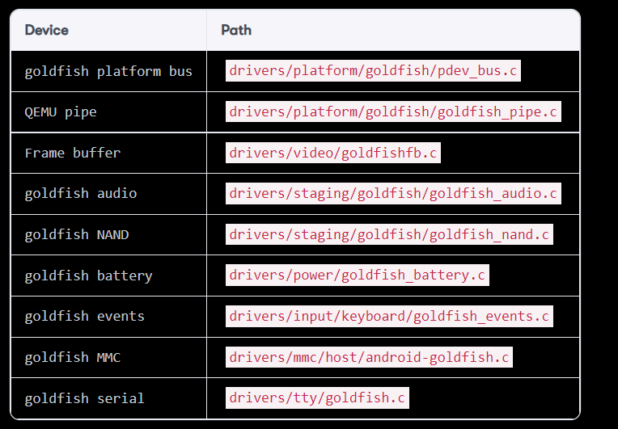
Notes:
The following table is a list of goldfish device drivers. This is based on kernel version 3.10.0. At the moment, kernel version 3.10.0 is for ranchu and 3.4.67 is for goldfish. The following table lists some goldfish specific devices. In ranchu, Virtio devices are used as block devices to simulate EMMC. Virtio devices are paravirtualized devices in QEMU that have better performance than emulated hardware devices.

Slide 98
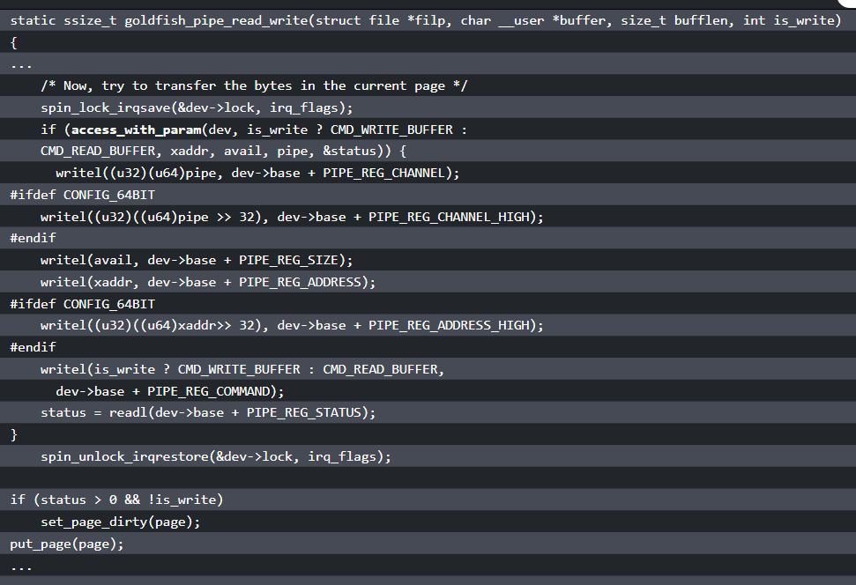
QEMU pipe
Notes:
Since QEMU pipe is used as a channel to emulate many goldfish devices, we can review one of the major functions, goldfish_pipe_read_write, to understand data transmission between guest and host:
As we can see from the preceding code, it invokes the access_with_param function first. This is the fastest way to transfer data between the guest and emulator using shared memory. With this method, the goldfish kernel allocates a piece of memory at boot time. The guest and emulator will use this shared memory to transfer parameters between them.

Slide 99
QEMU pipe
If the access_with_param function fails, it will use the following sequence to transfer data through the QEMU pipe device:
write_channel(<channel>)
write_address(<buffer-address>)
REG_SIZE = <buffer-size>
REG_CMD = CMD_WRITE_BUFFER/CMD_READ_BUFFER
status = REG_STATUS

Slide 100
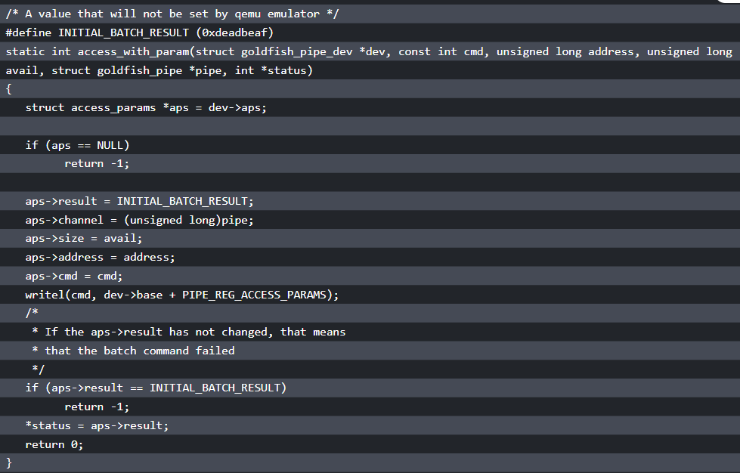
QEMU pipe
Notes:
Now let's take a look at the access_with_param function as follows:
The address of aps is the pre-allocated shared memory between the guest and emulator. All data structures that need to be used for a single operation are filled in this data structure aps. The command will be written to register PIPE_REG_ACCESS_PARAMS. The write to PIPE_REG_ACCESS_PARAMS will trigger the operation. QEMU will read the content of the access_params block, use its fields to perform the operation, and then write back the return value into aps->result. The difference between shared memory aps and the QEMU pipe device is similar to DMA and register-based device I/O. The shared memory or DMA is much more efficient in large blocks of memory access.
You can explore the rest of the goldfish device drivers by yourself.

Slide 101
Summary
In this lesson, we introduced the content of the AOSP source code.
After that, we used goldfish lights HAL as an example to analyze the calling sequence from the application to HAL.
Finally, we reviewed the Android architecture again using the Android system for the emulator.
We also reviewed goldfish kernel and hardware to understand how they work together with the rest of the software stacks.
Notes:
In the next lesson, we will start to work on our own x86emu device and use it to explore how to extend an emulator to support additional functionalities.

